Slide 1
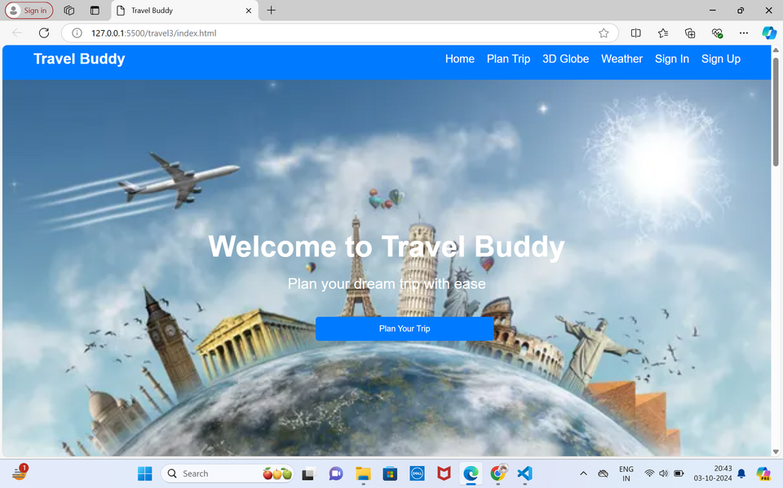

TRAVEL PLANNER
(TRAVEL BUDDY)
By: BATCH 10
K.Sree Sai Chandana(1602-22-733-122)
S.Sushank (1602-22-733-125)

Slide 2
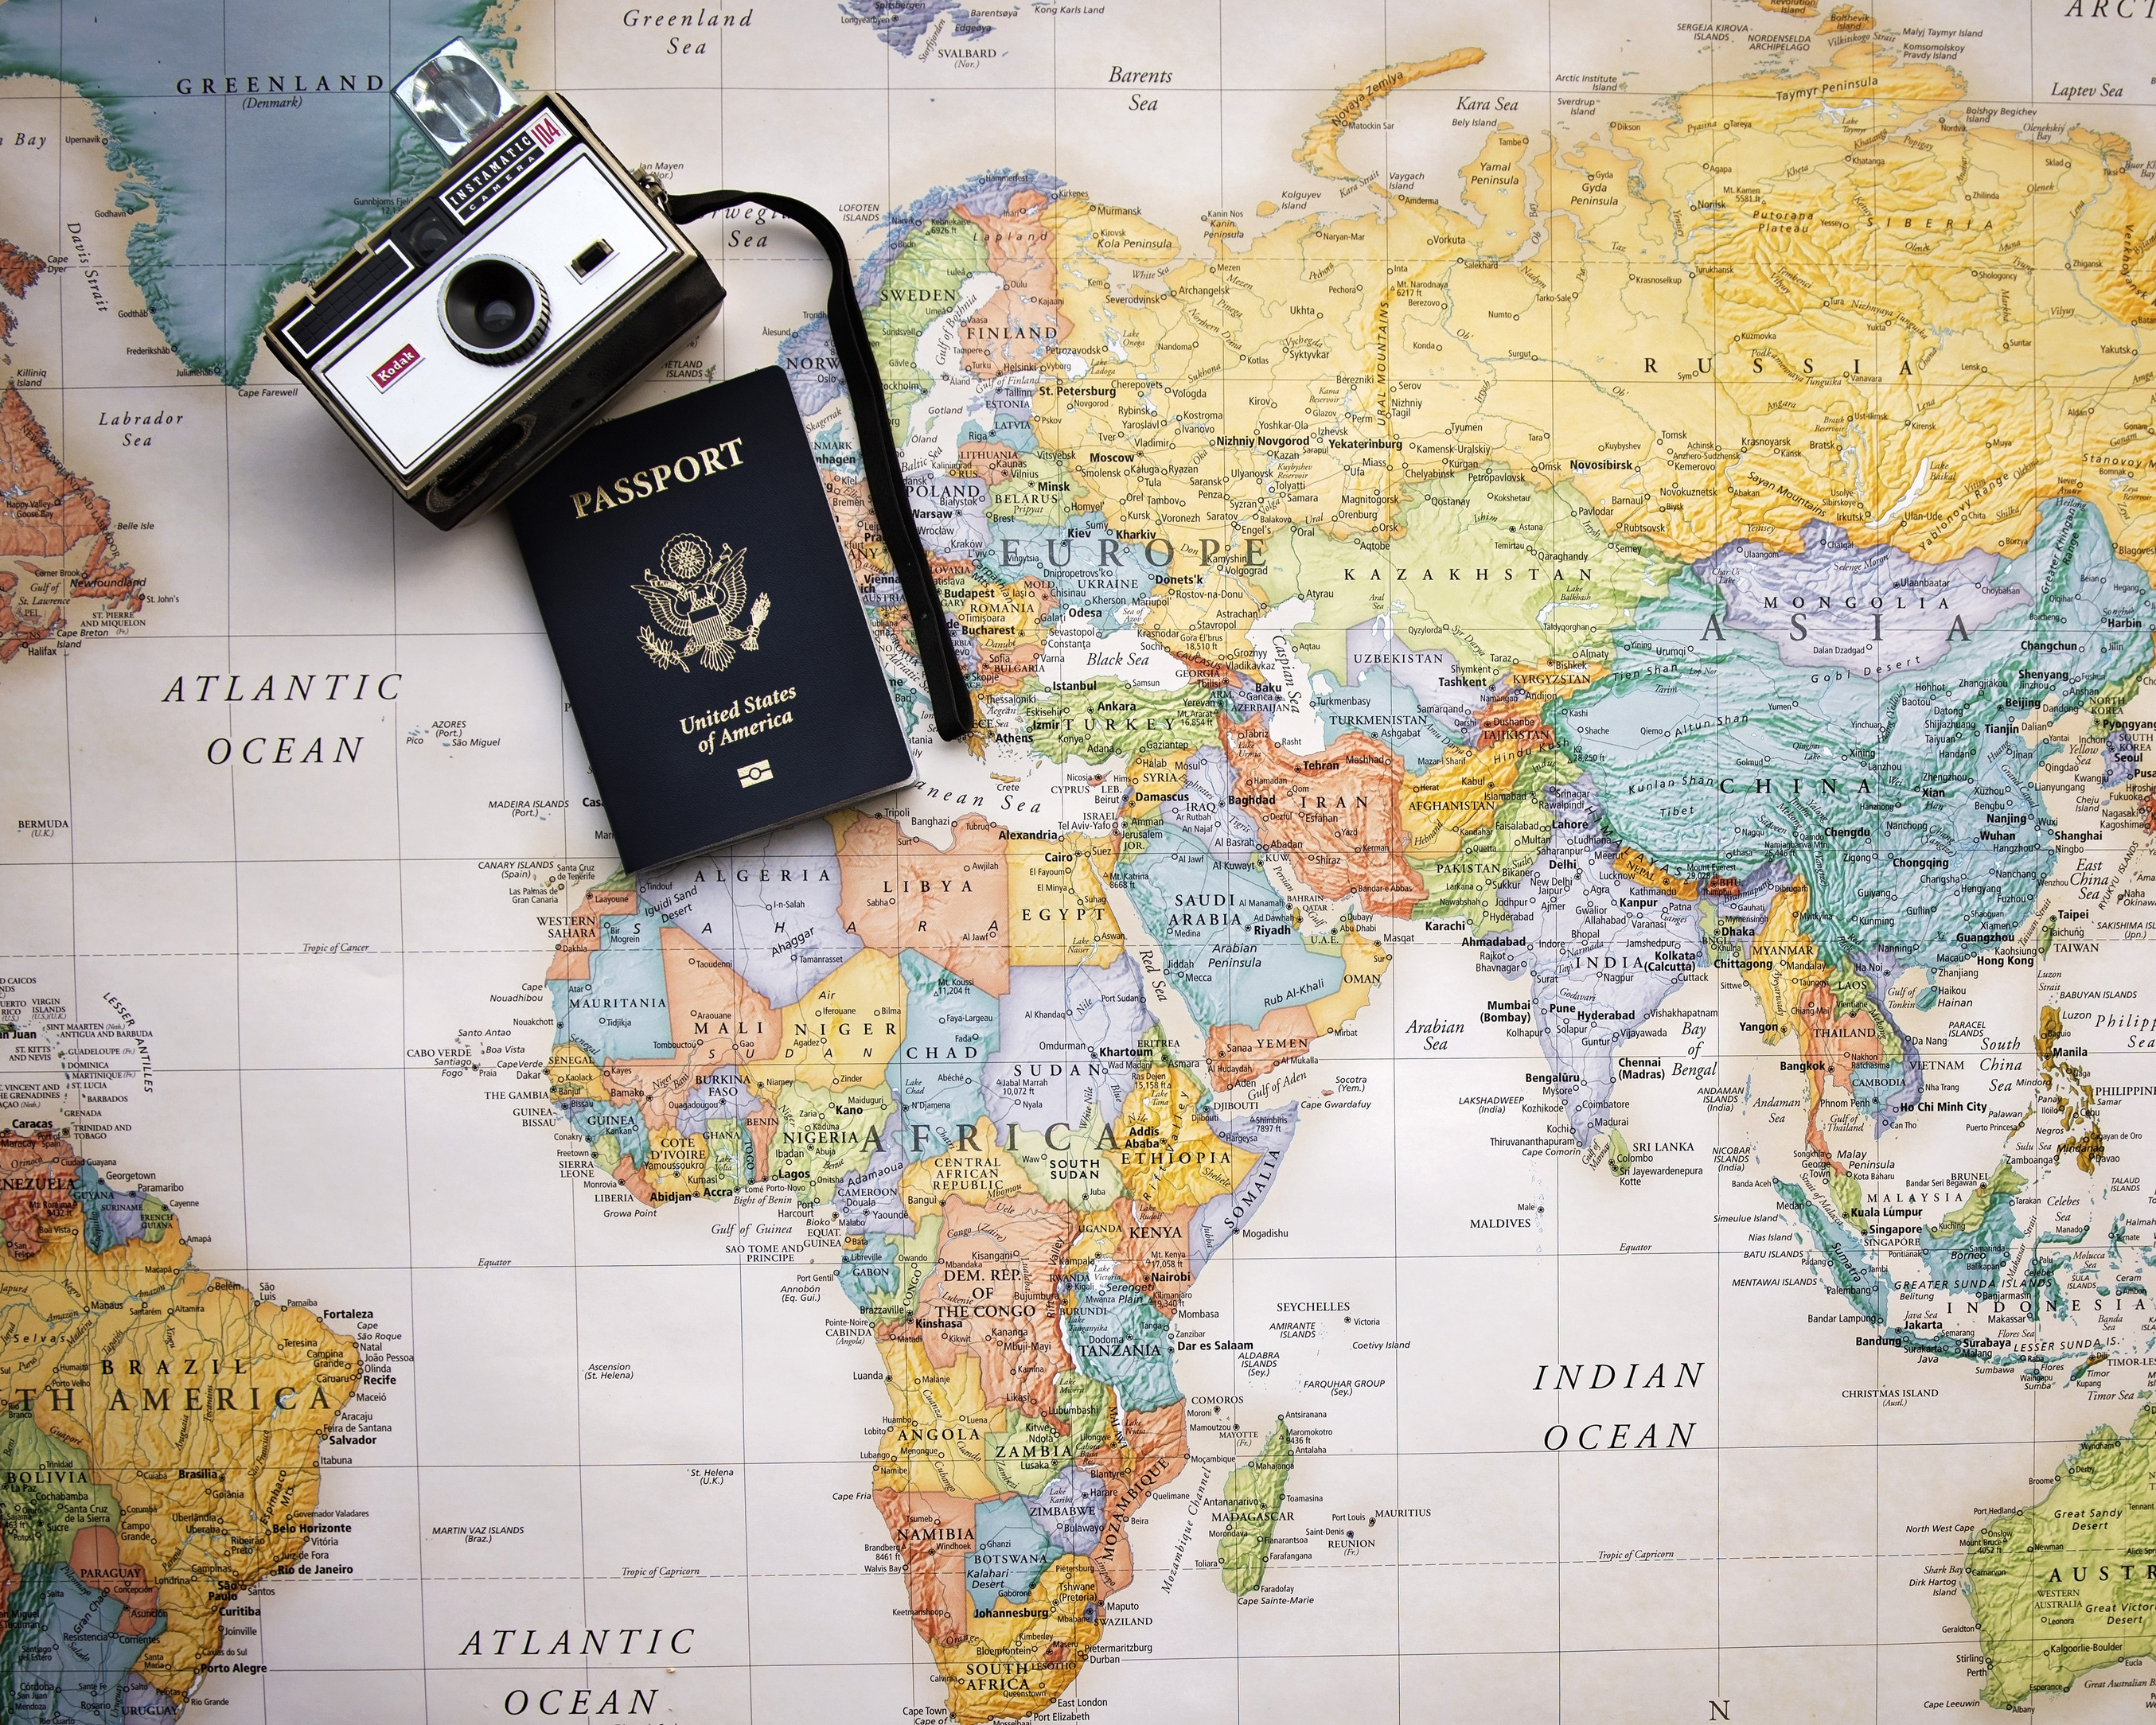
Introduction
Problem:The Challenge of Travel Planning
Travelers face challenges in organizing and planning trips efficiently.
Managing bookings, itineraries, and budgets can be time-consuming and overwhelming.
Lack of a centralized platform to handle all aspects of trip planning.
Difficulty in finding personalized recommendations for destinations, accommodations, and activities.

Slide 3

Introducing Travel Buddy
Travel Itinerary Generator is a computer program that empowers travelers to effortlessly create personalized travel itineraries. By considering users' interests, budgets, and travel dates, this application generates comprehensive lists of activities, attractions, and accommodations. Whether you're an experienced traveler or a novice, the Travel Itinerary Generator is your key to saving time and ensuring an enriching and well-rounded travel experience.

Slide 4

Objectives
Provide a seamless and user-friendly platform for planning, organizing, and managing trips from start to finish.
Objective 01
Objective 02
Objective 03
To provide users with automated, detailed travel plans based on basic inputs like destination and travel dates.
Cost estimation and budgeting.
Estimate the total cost of trip based on accomodatins, transportation, activities
Allowing users to look at the weather forecast for the place they would like to visit so that they can plan on dresses and places they can go to

Slide 5
Importance
Time-Saving: Automates the process of trip planning, helping users quickly generate detailed travel plans.
Enhanced Trip Experience: Provides access to up-to-date information about destinations, including weather and local attractions.
Increased Accessibility: Offers a simple, user-friendly platform, making it easy for travelers of all experience levels to plan their trips effectively.

Slide 6

01
Automated Itinerary Generation: Quickly creates travel plans based on user inputs like destination, start date, and duration.
Real-Time Weather Integration: Provides up-to-date weather forecasts for the travel dates to help users plan their activities better.
02
Key
features
Points of Interest Suggestions: Recommends popular attractions and must-visit places based on the selected destination.
03
User-Friendly Interface: Offers a clean and intuitive design, making it easy for users to navigate and plan their trips effortlessly.
04

Slide 7





FLOW CHART
Data Collection Stage:
The application retrieves weather data and popular points of interest using integrated APIs.
Output Stage:
The user receives a detailed itinerary with weather updates and recommended places to visit.
1
2
3
4
5
User Input Stage:
User provides basic details: destination, start date, and duration of the trip.
Review Stage:
Users can view and utilize the generated itinerary directly for their travel planning.
Itinerary Generation Stage:
The system compiles the information and creates a suggested itinerary for the user.

Slide 8
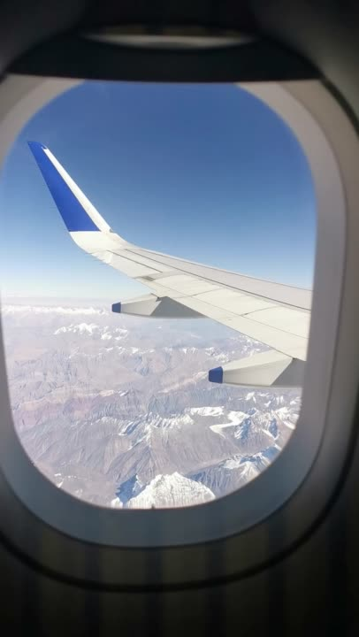

TECH STACK
Frontend:
HTML, CSS: For creating the user interface.
JavaScript: For enhancing interactivity.
Backend:
Python (Flask): Used for server-side logic and API handling.
APIs:
Google PaLM API: Integrated for generating content and recommendations.
Visual Crossing Weather API: Used for fetching real-time weather data.
Database:
Flask-SQLAlchemy (SQLite): For handling data storage temporarily.

Slide 9

Marketing Strategies
Social Media Engagement
Utilize Instagram, TikTok, and Facebook with travel tips and user content.
Content Marketing
Share travel blogs, destination guides, and user stories.
Referral Program
Incentivize users to refer friends for exclusive rewards.
Partnerships
Collaborate with local businesses and tourism agencies for mutual promotion.
Email Campaigns
Send personalized newsletters with travel updates and offers.
Targeted Ads
Run paid campaigns on Google and social platforms to reach travel enthusiasts.

Slide 10
Future improvements
In the future, we plan to enhance the Travel Itinerary Generator by introducing multi-destination itinerary support, allowing users to plan trips with multiple stops. We also aim to integrate hotel and flight suggestions to offer a complete travel planning experience. Additionally, real-time collaboration features will be implemented, enabling users to share and collaborate on itineraries with their travel companions.
Other improvements will focus on advanced personalization, providing recommendations based on detailed user preferences such as activity types and trip goals. We also plan to introduce more detailed budgeting tools to help users manage and optimize their travel expenses, creating a more comprehensive and tailored experience.

Slide 11

References
Aayushi Bhansali, Niharika Premkumar, Parshav
Pagariya, Varun Jain, Vikas Mahansaria, Sharan
Varma "Trip Itinerary Planner", International Journal
for Research in Applied Science & Engineering
Technology (IJRASET), 2023.

Slide 12



Conclusion
The Travel Itinerary Generator is a powerful tool designed to simplify travel planning by offering personalized itineraries based on user interests, budget, and travel dates. With features like weather forecasting and optimized trip schedules, it helps users create seamless, memorable travel experiences.
As we continue to enhance the platform, the introduction of multi-destination support, hotel and flight suggestions, and real-time collaboration will elevate the user experience, making it even more comprehensive. We’re excited to see how these improvements will help travelers plan their dream trips with ease and convenience.

Slide 13


THANKYOU

